Slide 1



K8s Basics

Slide 2
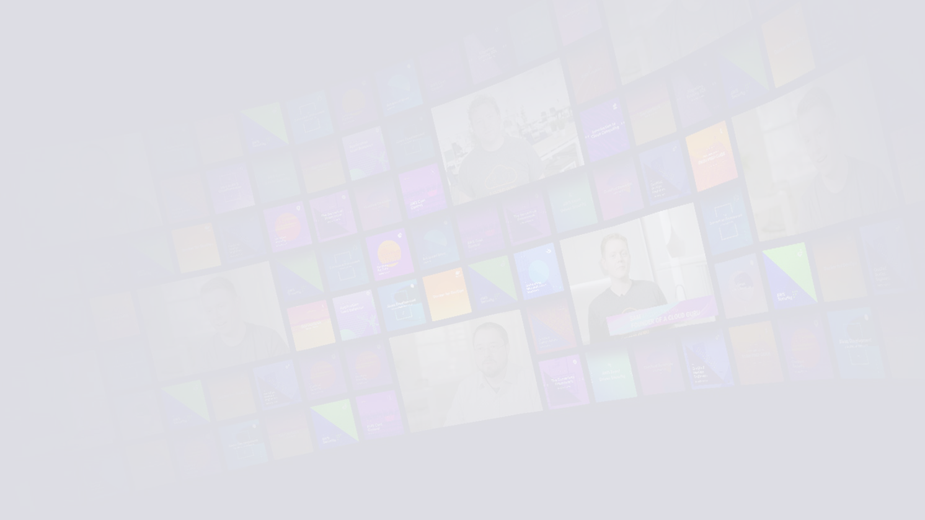


K8s Basics
LESSON BREAKDOWN
What Is Kubernetes?
What Does “K8s” Mean?
The K8s Cluster
K8s Features

Slide 3
“Kubernetes is a portable, extensible, open-source platform for managing containerized workloads and services, that facilitates both declarative configuration and automation.”
Kubernetes Official Documentation

Slide 4








What Does
“K8s” Mean?
K8s is simply short for Kubernetes. The 8 represents the 8 letters between K and S!

Slide 5

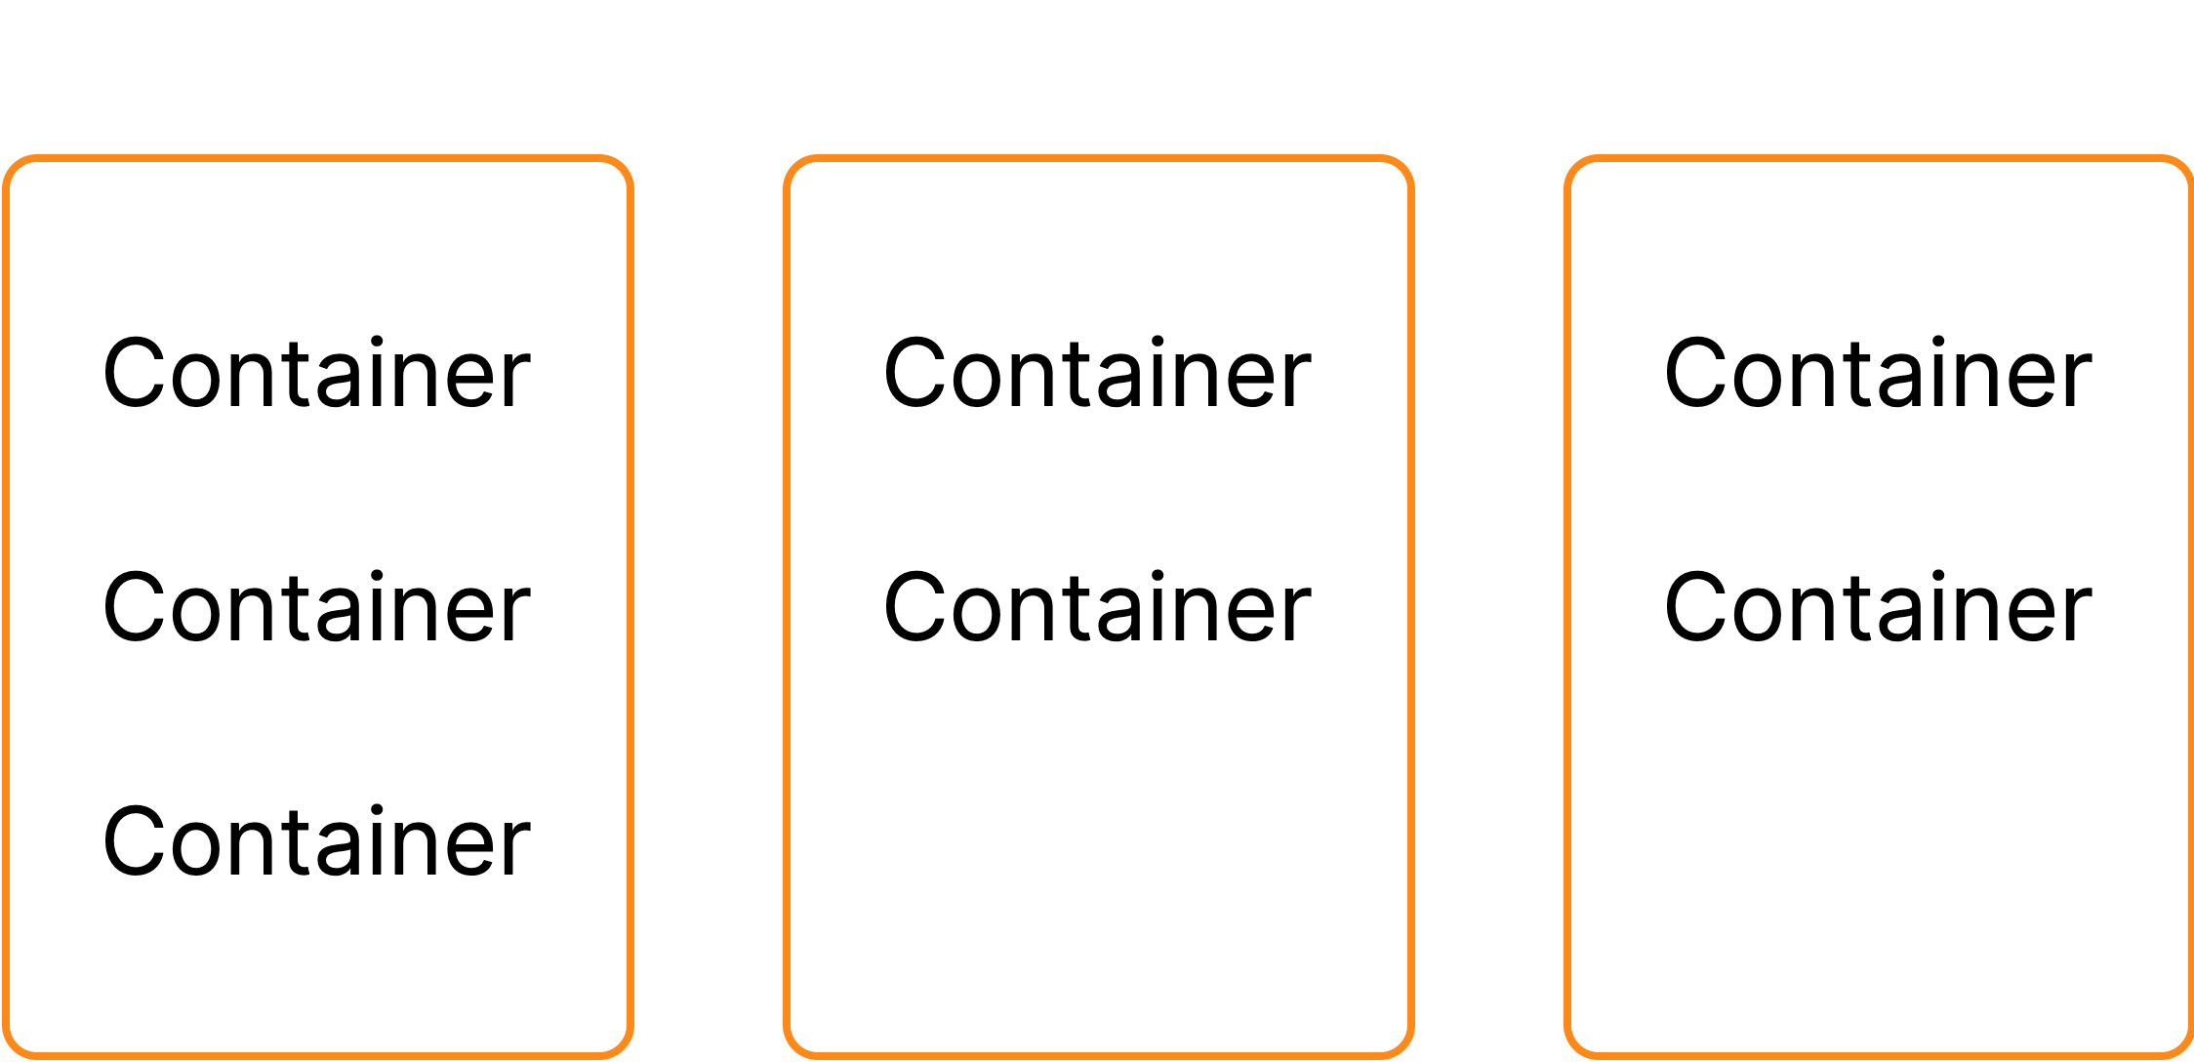
K8s Cluster
K8s Cluster

Slide 6





K8s Basics
K8s Features
Container Orchestration
The primary purpose of Kubernetes is to dynamically manage containers across multiple host systems.
Application Reliability
Kubernetes makes it easier to build reliable, self-healing, and scalable applications.
Automation
Kubernetes offers a variety of features to help automate the management of your container apps.

Slide 7

K8s Architectural Overview

Slide 8

K8s Control Plane
K8S ARCHITECTURAL OVERVIEW

Slide 9
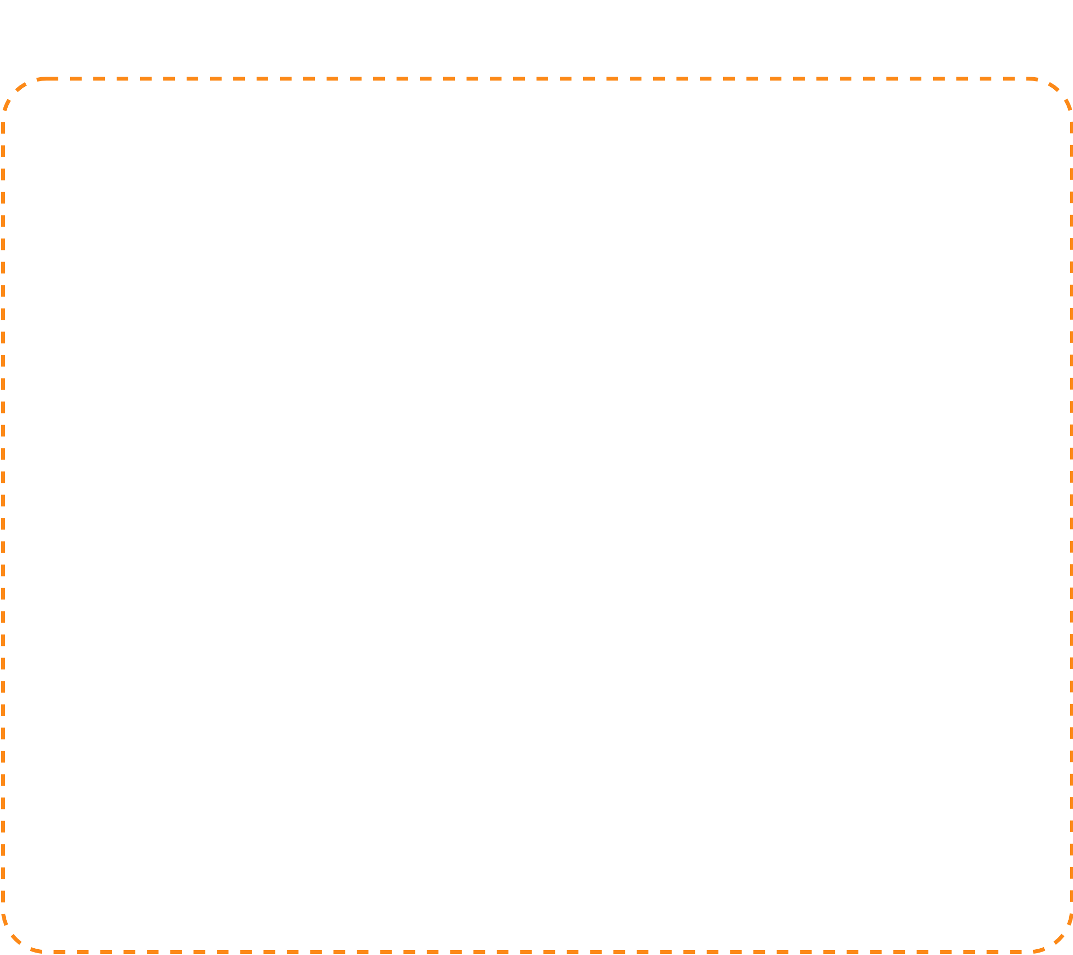









K8s Control Plane
K8S ARCHITECTURAL OVERVIEW
The control plane is a collection of multiple components responsible for managing the cluster itself globally. Essentially, the control plane controls the cluster.
Individual control plane components can run on any machine in the cluster, but usually are run on dedicated controller machines.

Slide 10
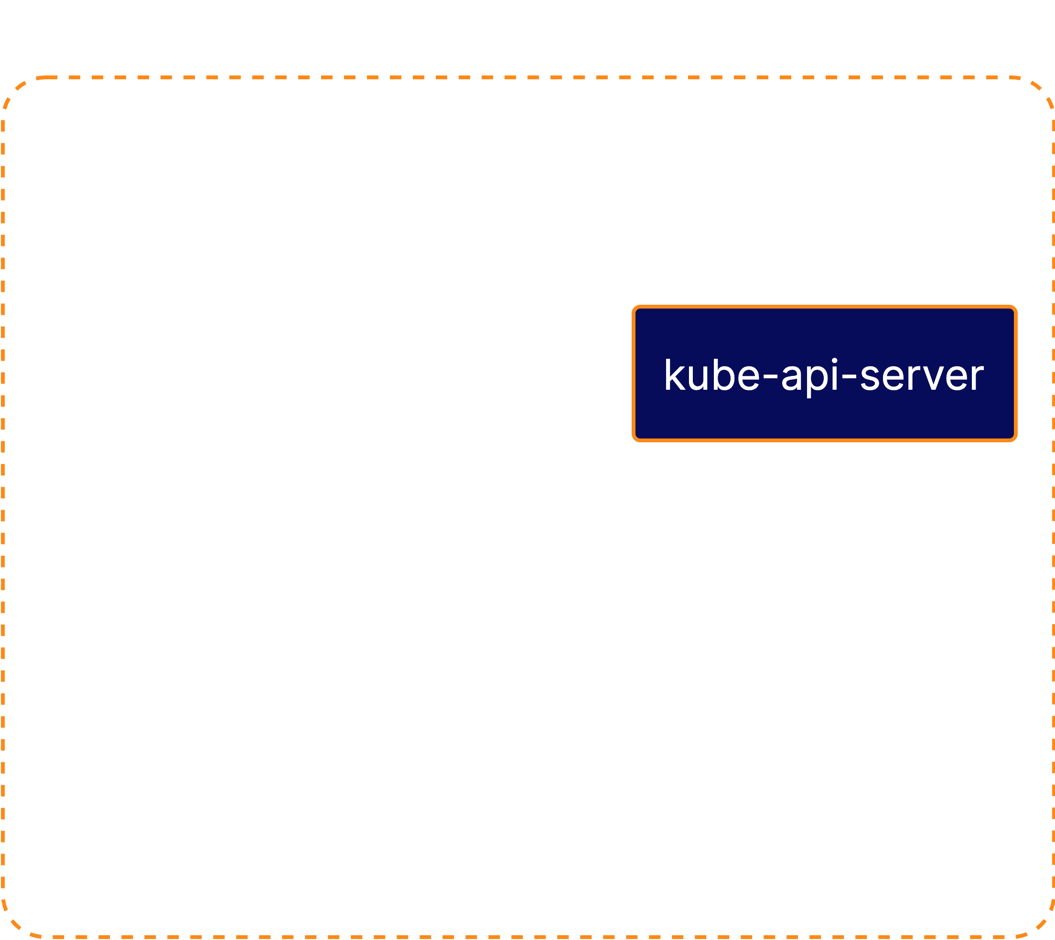











K8s Control Plane
K8S ARCHITECTURAL OVERVIEW
kube-api-server serves the Kubernetes API, the primary interface to the control plane and the cluster itself.
When interacting with your Kubernetes cluster, you will usually do so using the Kubernetes API.

Slide 11
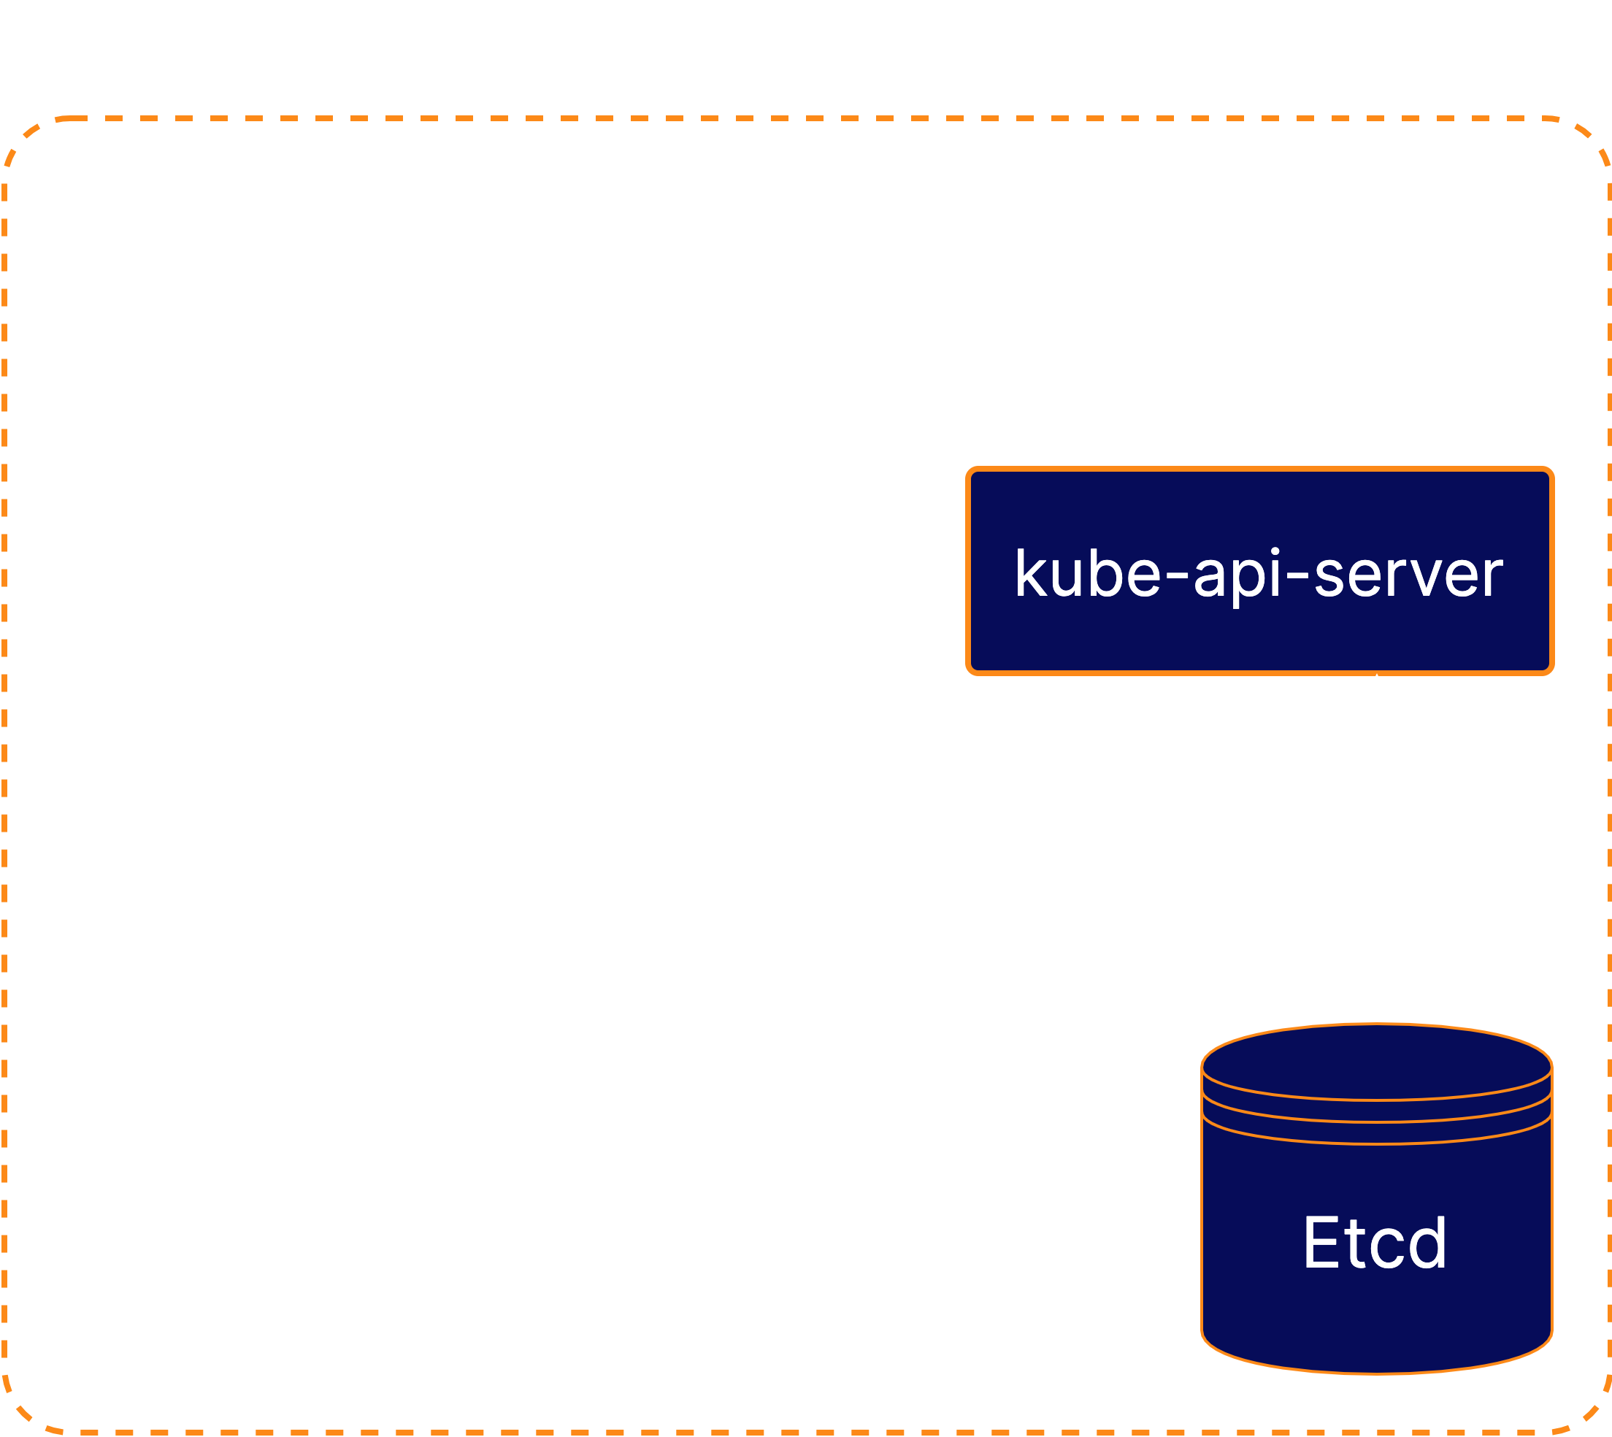





K8s Control Plane
K8S ARCHITECTURAL OVERVIEW
Etcd is the backend data store for the Kubernetes cluster. It provides high- availability storage for all data relating to the state of the cluster.

Slide 12
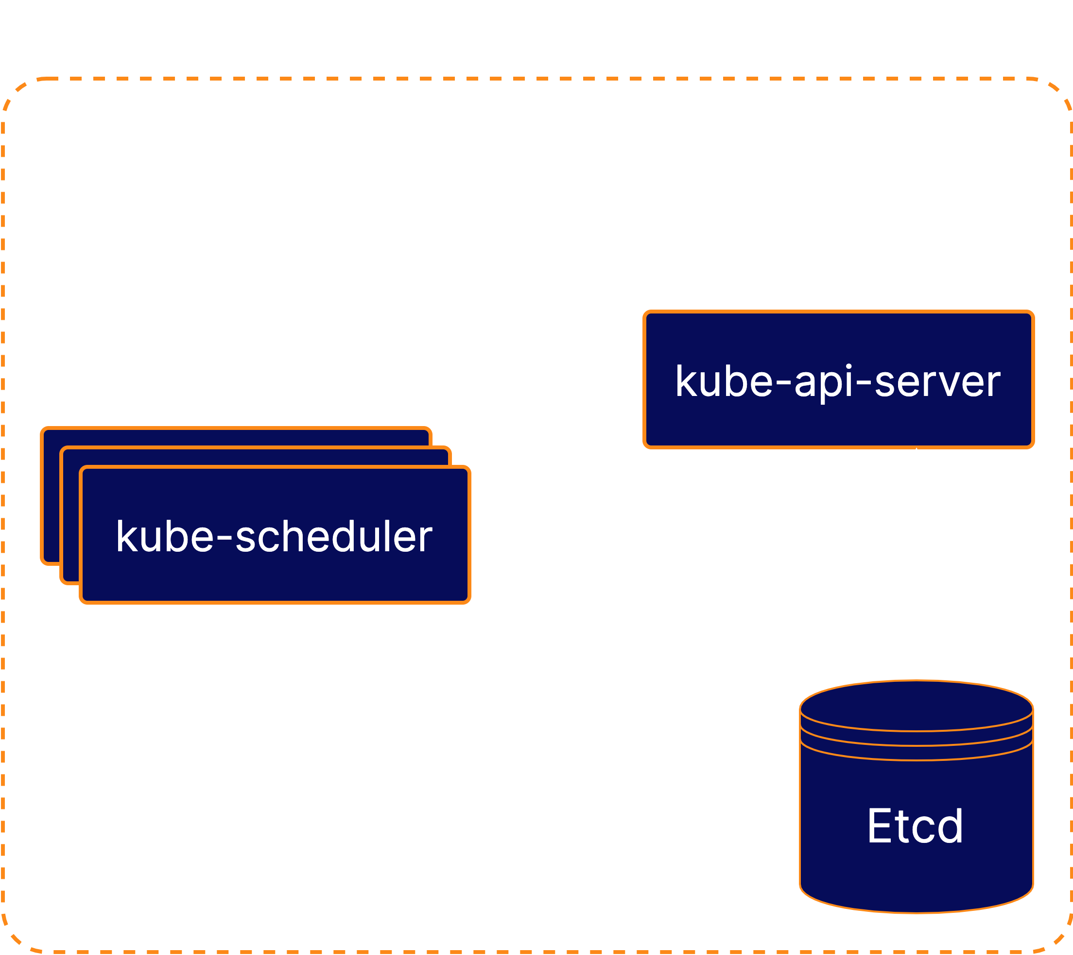






K8S ARCHITECTURAL OVERVIEW
K8s Control Plane
kube-scheduler handles scheduling, the process of selecting an available node in the cluster on which to run containers.

Slide 13
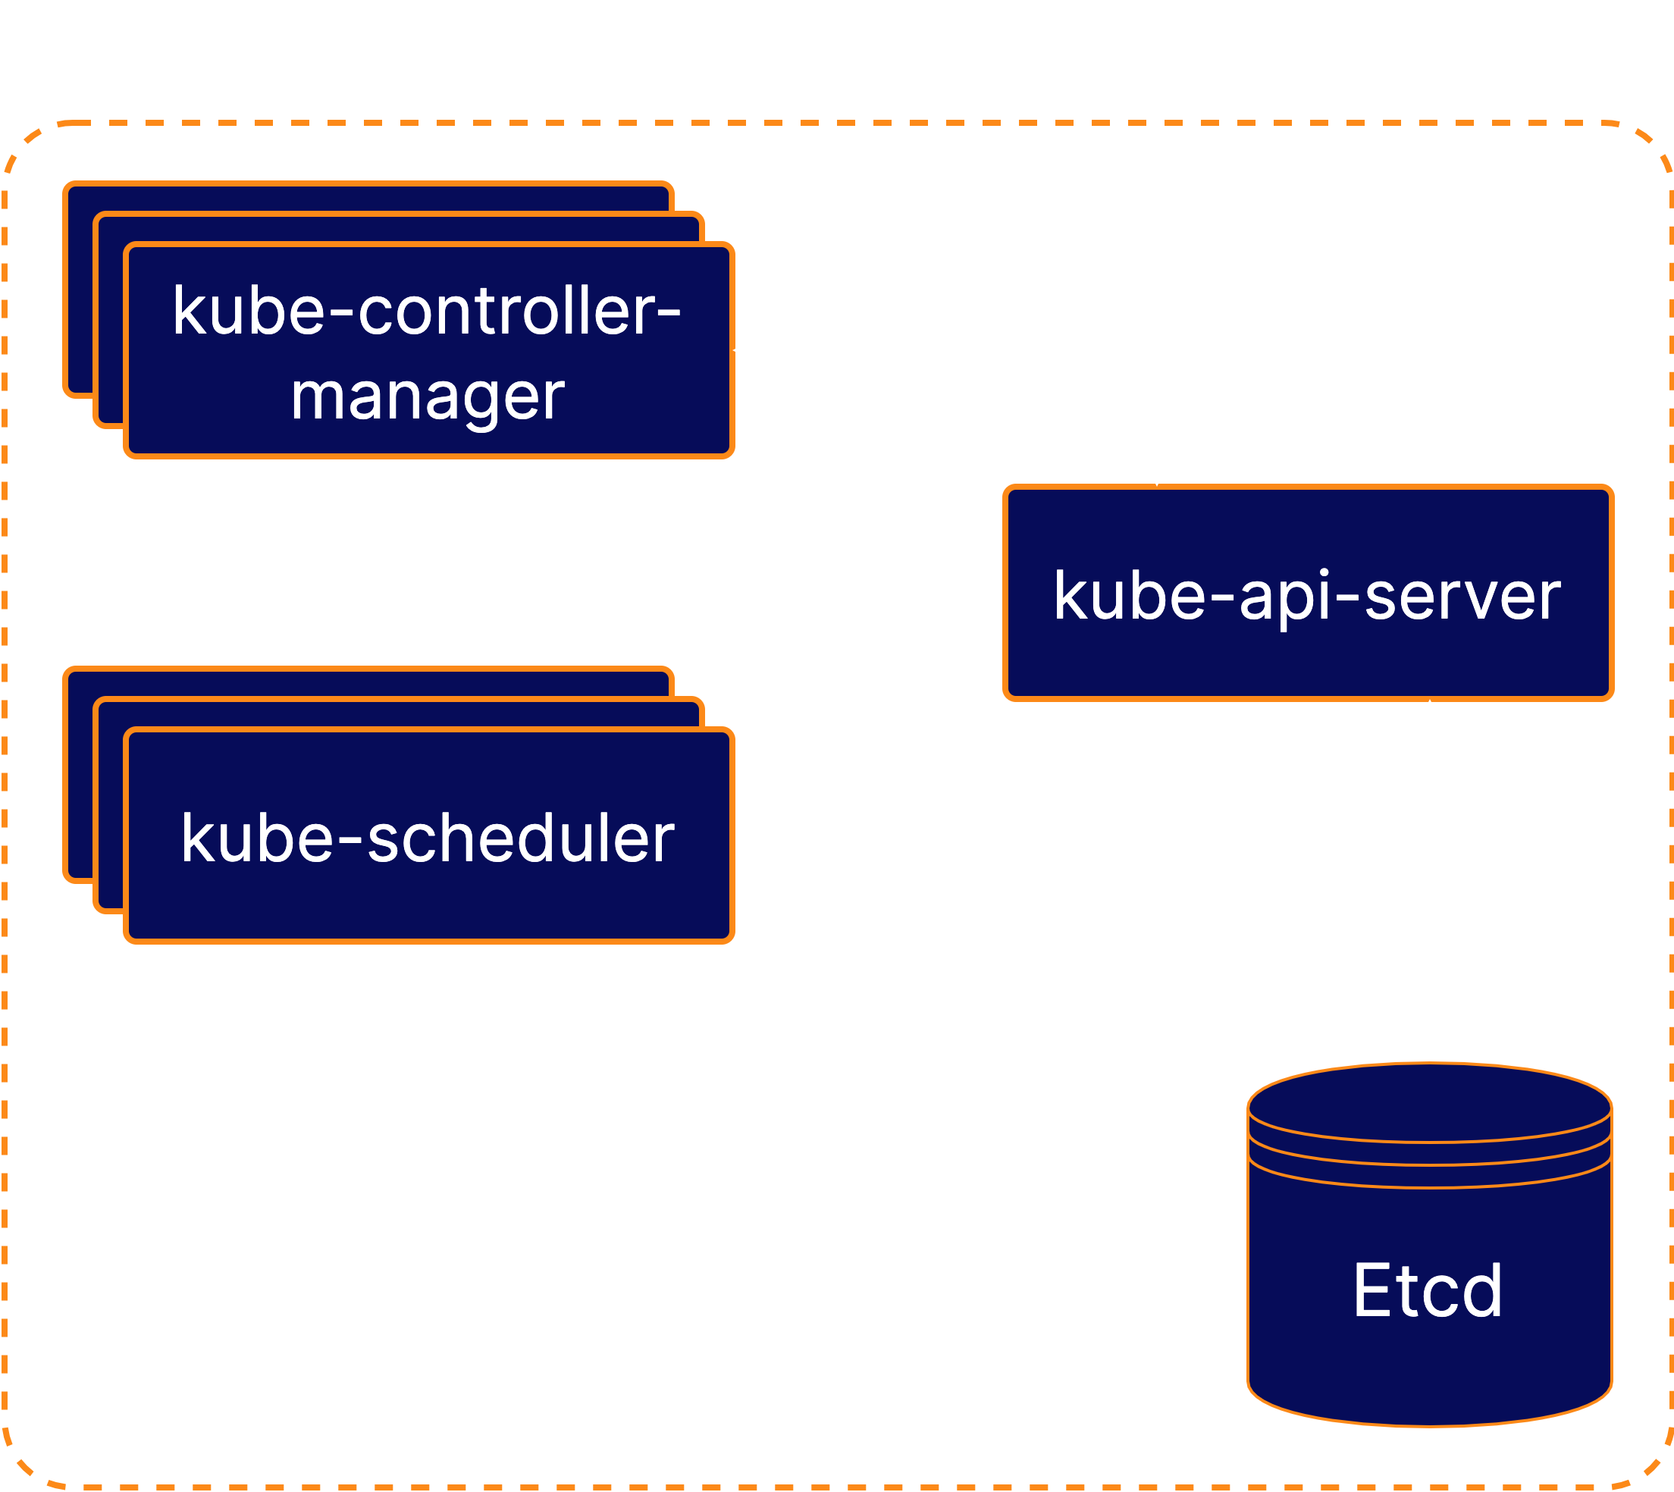






K8s Control Plane
K8S ARCHITECTURAL OVERVIEW
kube-controller-manager runs a collection of multiple controller utilities in a single process. These controllers carry out a variety of automation-related tasks within the Kubernetes cluster.

Slide 14
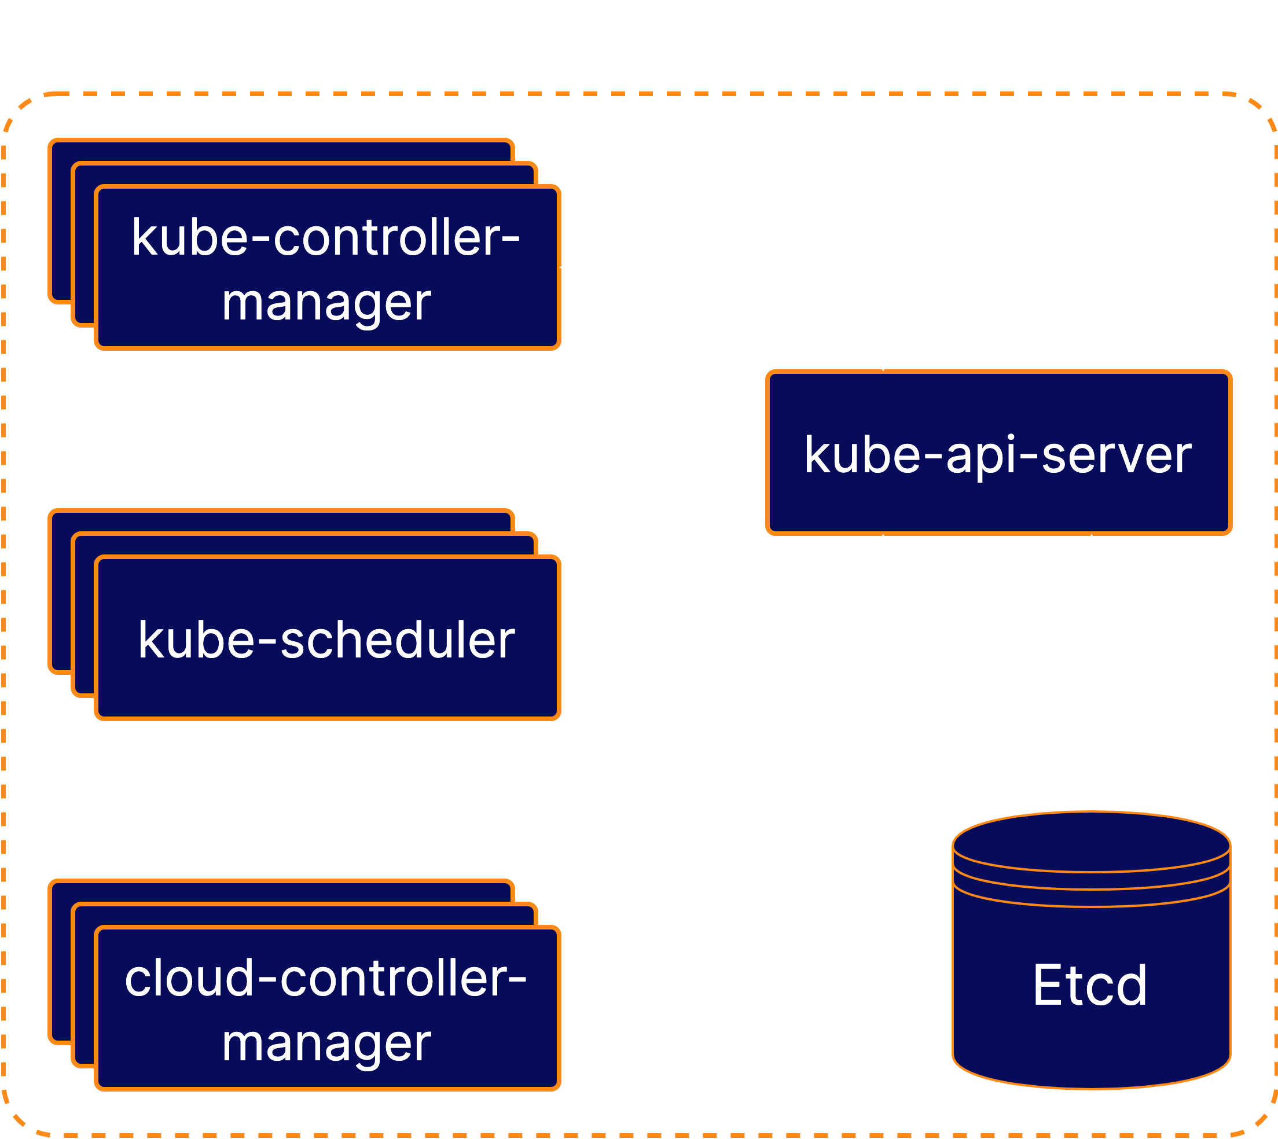


K8s Control Plane
K8S ARCHITECTURAL OVERVIEW
cloud-controller-manager provides an interface between Kubernetes and various cloud platforms. It is only used when using using cloud-based resources alongside Kubernetes.

Slide 15

K8s Nodes
K8S ARCHITECTURAL OVERVIEW

Slide 16
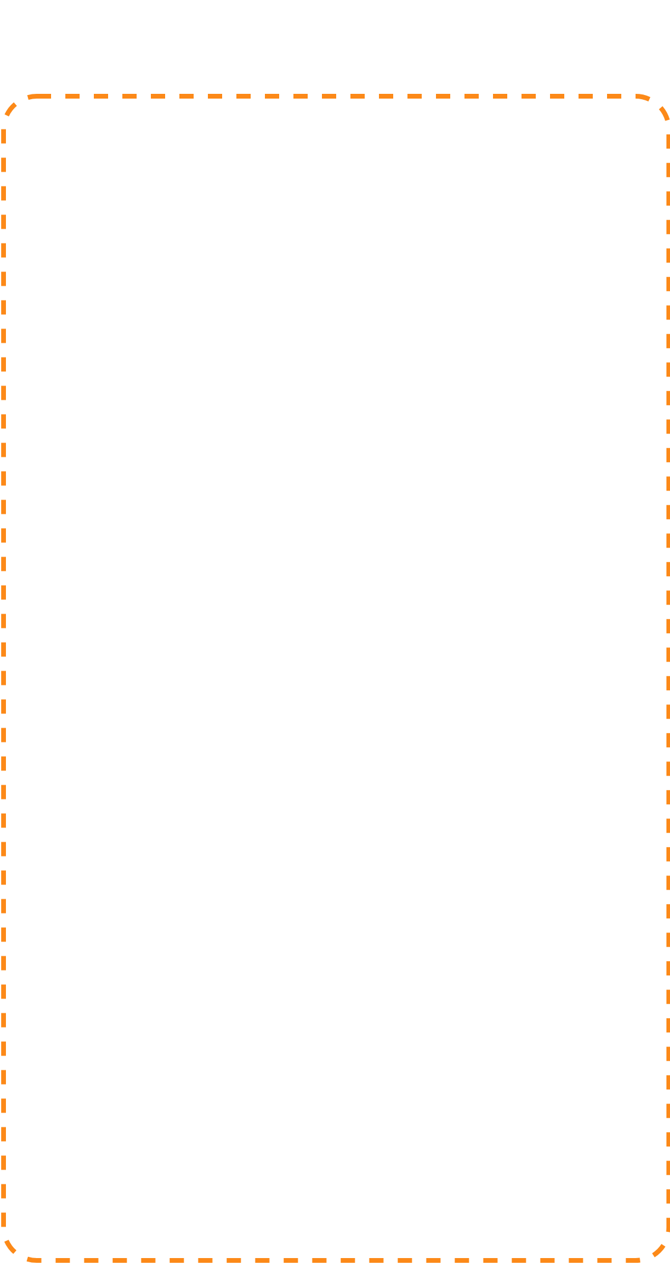








K8s Nodes
K8S ARCHITECTURAL OVERVIEW
Kubernetes Nodes are the machines where the containers managed by the cluster run. A cluster can have any number of nodes.
Various node components manage containers on the machine and communicate with the control plane.

Slide 17
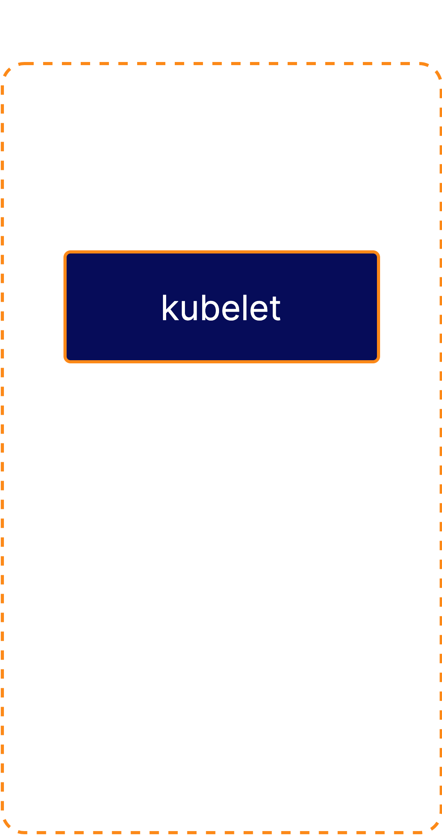








K8s Nodes
K8S ARCHITECTURAL OVERVIEW
Kubelet is the Kubernetes agent that runs on each node. It communicates with the control plane and ensures that containers are run on its node as instructed by the control plane.
Kubelet also handles the process of reporting container status and other data about containers back to the control plane.

Slide 18
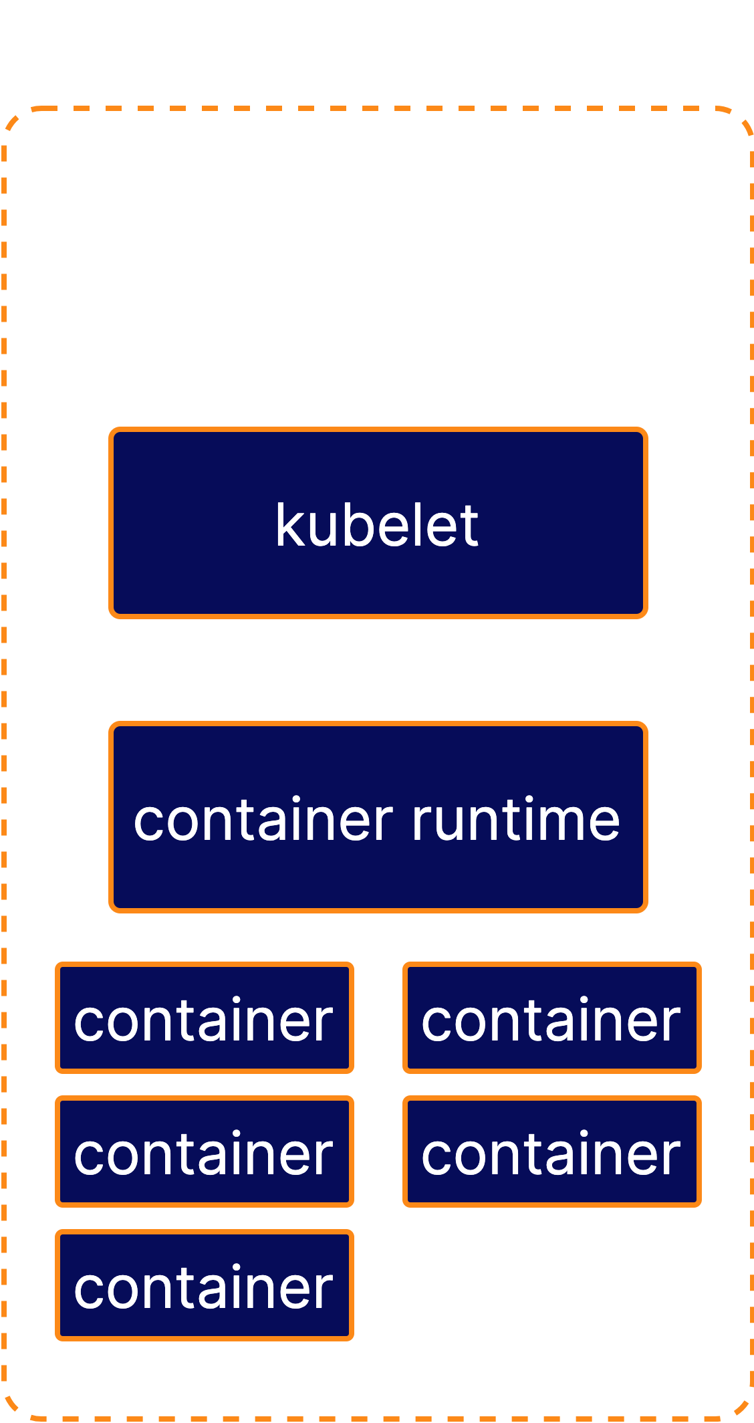












K8s Nodes
K8S ARCHITECTURAL OVERVIEW
The container runtime is not built into Kubernetes. It is a separate piece of software that is responsible for actually running containers on the machine.
Kubernetes supports multiple container runtime implementations. Some popular container runtimes are Docker and containerd.

Slide 19
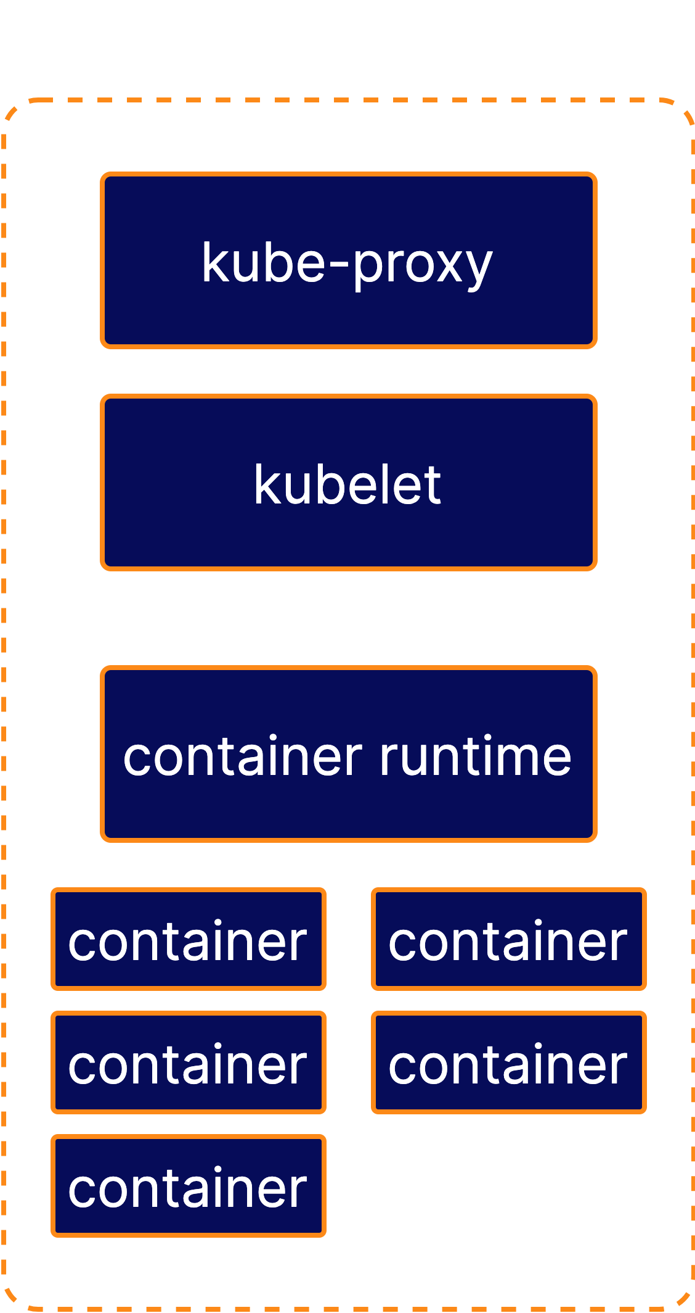





K8s Nodes
K8S ARCHITECTURAL OVERVIEW
kube-proxy is a network proxy. It runs on each node and handles some tasks related to providing networking between containers and services in the cluster.

Slide 20


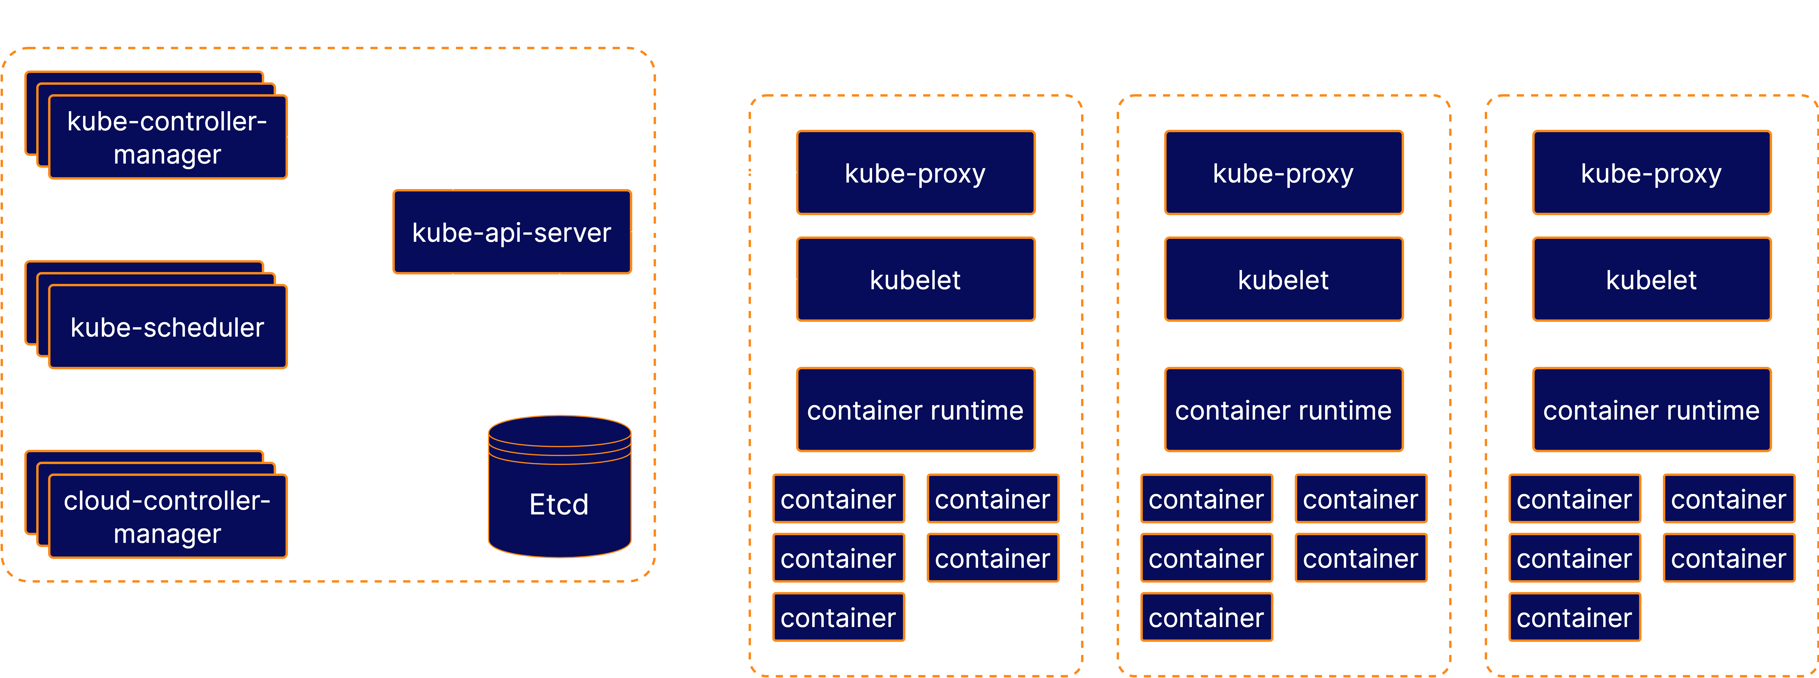
K8s Architecture
K8S ARCHITECTURAL OVERVIEW
A K8s Cluster - The Big Picture

